Slide 1
The Power of Royals
Brand Finance
April 2023

Slide 2
Project context & method
Why? Project background
Who? Target audience
How? Method
What? Key questions
Brand Finance wanted to better understand awareness, familiarity and impact of Royal Warrants on perceptions and value for products in Auto, Alcohol and Apparel Industries.
We invited a UK nationally representative audience to participate in this insights project.
In places we compare results to a UK Audience Control Group who have not been asked about Royal Warrants. This information is collected within the Brand Finance Global Brand Equity Monitor survey and have robust base numbers in excess of 150.
35 question, online quantitative survey: c.10 minutes to complete
903 UK residents, sample matched to National Representation in terms of core demographics (Age, Gender, Region etc.)
c.300 respondents were asked about each industry.
Fieldwork conducted April 19th – 24th, 2023
Investigating:
Awareness and familiarity with Royal Warrants, and brands which currently hold them
Impact of Royal Warrants on brand perceptions and value

Slide 3
Executive Summary
62% of the UK public are aware of Royal Warrants, with 36% indicating they are familiar with what they are. Spontaneously, UK consumers identify that Royal Warrants are attached to different types of brands and products, from everyday staples like Heinz, Cadbury and Kellogg's, to high end brands (Fortnum & Mason, Harrods) and services (Royal Mail, BT)
Royal Warrants show an ability to reinforce and build associations, particularly Britishness, as well as perceptions of being reputable, premium, high quality and trustworthy
Comparing those who are made aware that specific Automobile brands have Royal Warrants versus those who are not explicitly told, we see an uplift in perceptions of the brand / product being luxurious (+14%), a symbol of success (+9%) and stylish (+6%)
Having a Royal Warrant also improved reputation for Auto (+1%), Apparel (+1%) and particularly Alcohol brands (+8%). The uptick in reputation for Alcohol translates to much higher levels of brand consideration (+15% on average)
Asked directly, many members of the public consciously indicate they would be willing to pay more for a brand with a Royal Warrant across industries: 12% would pay more for Auto brands with a Royal Warrant; 14% for Apparel brands; and 24% for Alcohol brands
Base: UK Nationally Representative Sample n=903

Slide 4
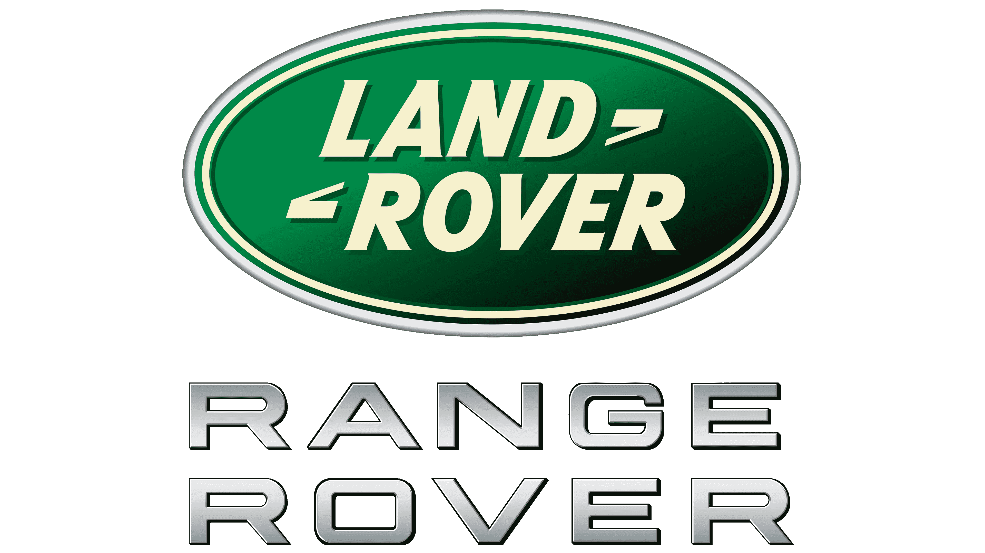
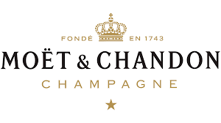
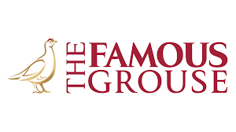
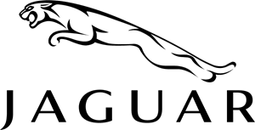
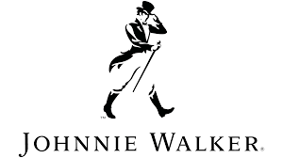
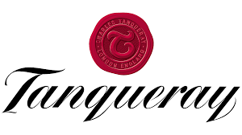
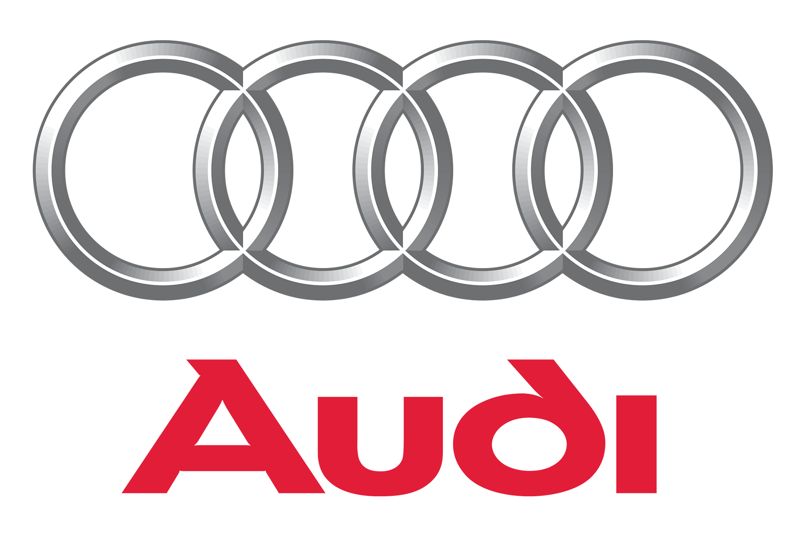
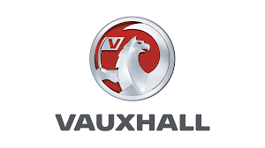
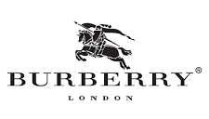
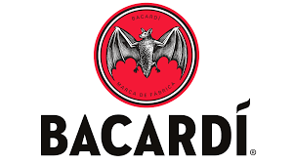
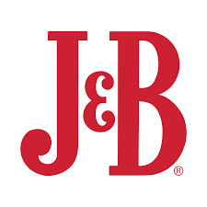
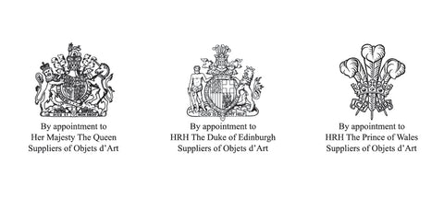
We investigated the impact of Royal Warrant associations across 3 key sectors
Sector Specific Insights – Intro
UK Nationally Representative Audience
Autos
Apparel
Alcohol
Base: UK Nationally Representative Sample n=903

Slide 5
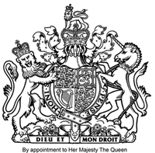
62% of the UK public are aware of Royal Warrants, with 36% indicating they are familiar with what they are
Awareness and Familiarity with Royal Warrants
UK Nationally Representative Audience
62%
Awareness
36%
Familiarity
Q. To what extent are you familiar with the Royal Warrants?
Base: UK Nationally Representative Sample n=903

Slide 6
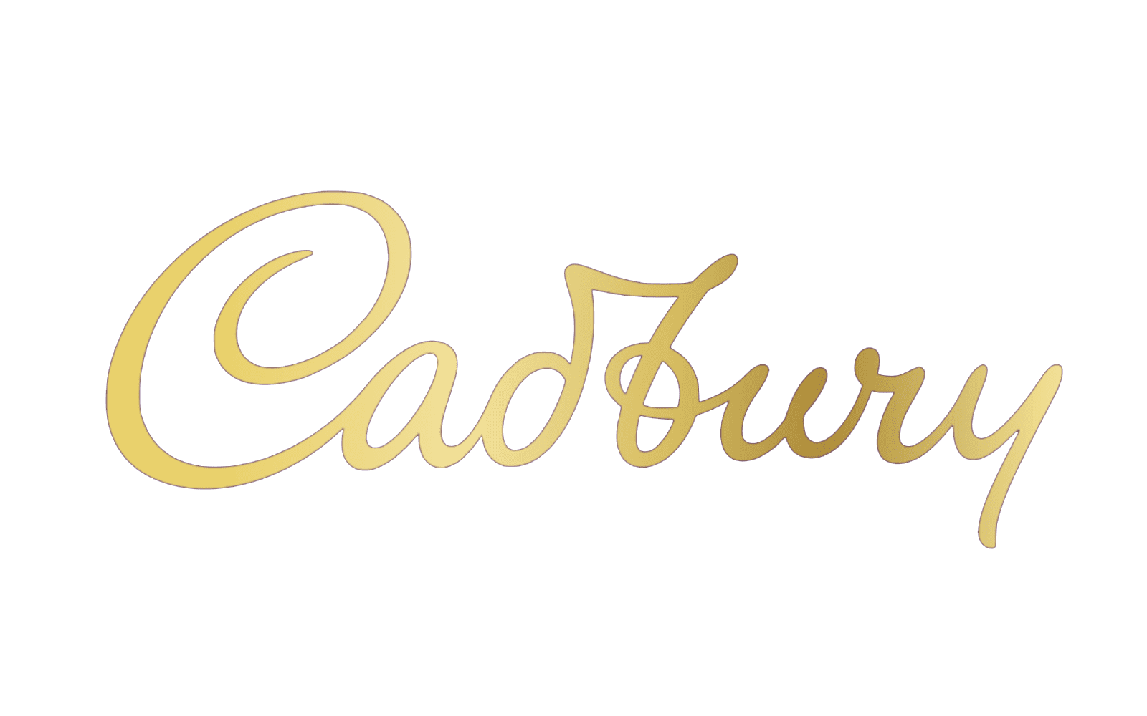
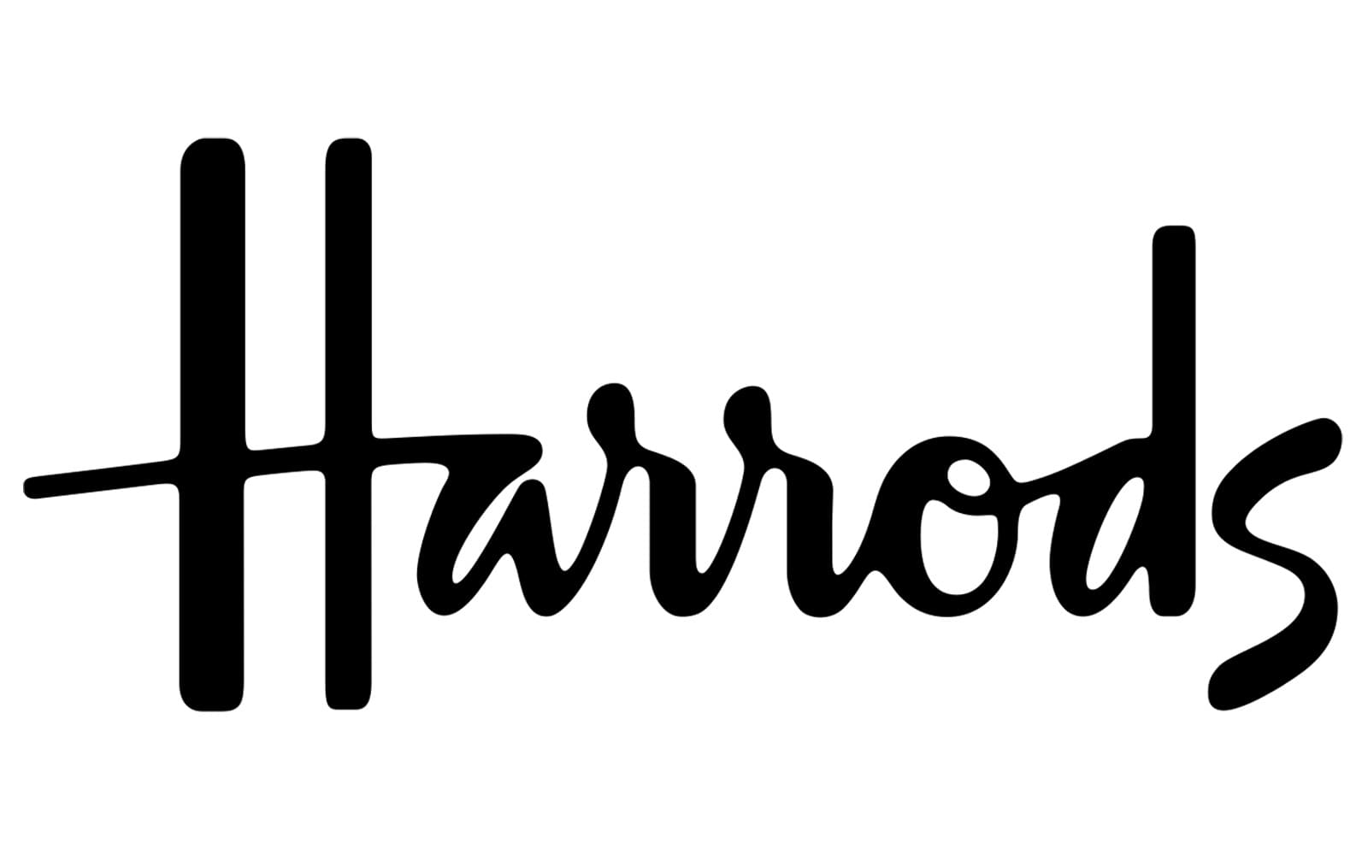
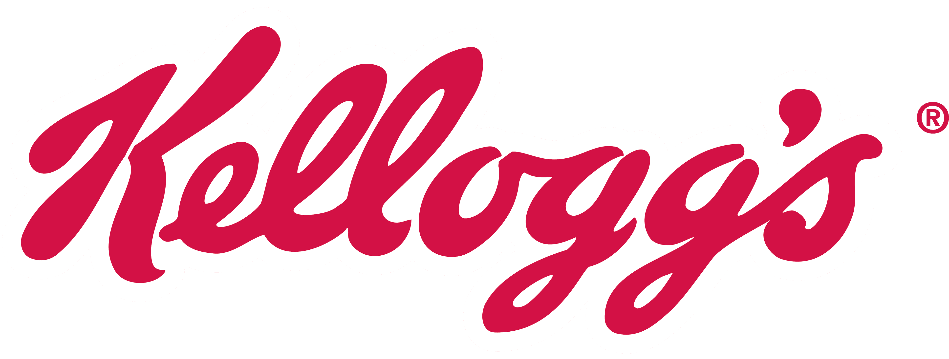
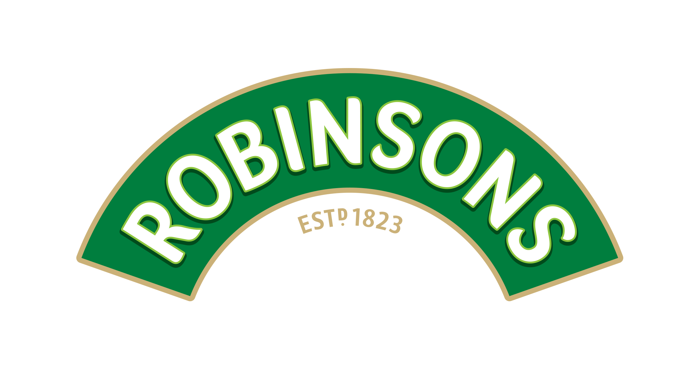
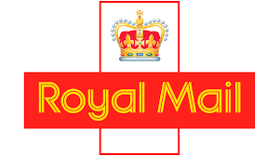
UK consumers identify that Royal Warrants are attached to different types of brands and products, from everyday staples to high end offerings
Brands Spontaneously Associated with Having Royal Warrants
UK Nationally Representative Audience
Iconic Luxury
Consumer Staples
Privatised Public Services
Q. What are the brands do you recall having a royal warrant?
Base: UK Nationally Representative Sample n=903
Notes:
In terms of spontaneous brand recall, no brand is distinguished as a royal warrant holder.
Cadbury, Fortnum & Mason, and Heinz had the most mentions as Royal Warrant Holders.
The FMCG brands are dominating the list of the 10 most recalled royal warrant holders.

Slide 7
Royal Warrants show an ability to reinforce associations of Britishness, as well as perceptions of being premium, high quality and trustworthy
Royal Warrant Associations
UK Nationally Representative Audience
Q. What comes to your mind when you see a product or service that has received a royal warrant’? Base: UK Nationally Representative Sample n=903

Slide 8
For Automobiles, Royal Warrant endorsement helps to build perceptions of the brand / product being luxurious, a symbol of success and stylish
Royal Warrant Association Impact for Automobile Sector
UK Nationally Representative Audience
Luxurious
A symbol of success
Stylish
Innovative
Modern
Great value for money
Q. Which attributes are more associated with Royal Warrant Holders in the automobile industry? Base: UK Nationally Representative Sample n=301; Control Group n=varies

Slide 9
Brand reputation improves when consumers are aware that a brand has a Royal Warrant, particularly for alcohol brands
Royal Warrant Impact on Brand Reputation
UK Nationally Representative Audience
+1%↑
+8%↑
+1%↑
Reputation Score /10
Autos
Apparel
Alcohol
Q. Out of 10, how good is the reputation of the brands listed below? Base: UK Nationally Representative Sample n=903 (301 per sector); Control Group n=varies

Slide 10
Consideration increases when consumers are aware an alcohol brand holds a Royal Warrant
Royal Warrant Impact on Consideration of Alcohol Brands
UK Nationally Representative Audience
15%
Average Increase In Consideration
Q. Out of 10, how good is the reputation of the brands listed below? Base: UK Nationally Representative Sample n=301; Control Group n=varies

Slide 11
With Royal Warrants showing the ability to build brand perceptions of being premium, quality etc., they can increase the perceived value of a brand
Royal Warrant Impact on Willingness to Pay More for Brands
UK Nationally Representative Audience
% of UK Consciously Willing to Pay More for Brands that have a Royal Warrant
Autos
Apparel
Alcohol
Q. Would you pay more for a brand if it had a royal warrant?
Base: UK Nationally Representative Sample n=903 (301 per sector) Control Group n=varies

